Slide 1
unit test
principle & practice

Slide 2
contents
Why
What
Where
How
When

Slide 3
why
单元测试在业界的生存情况
单元测试为什么被部分人讨厌
我的实践感受
工程师思维

Slide 4
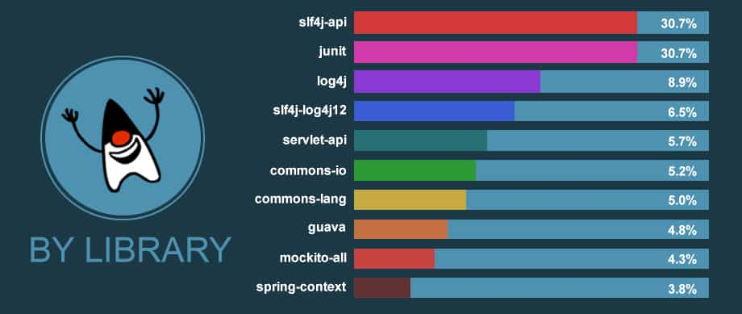
单元测试在业界的生存情况
*来源https://www.overops.com/blog/githubs-10000-most-popular-java-projects-here-are-the-top-libraries-they-use/
Google、Facebook等公司只保留很少的专职测试
*来源《 How Google Tests Software 》

Slide 5
单元测试为什么被部分人讨厌
单元测试导致工作量变大
不具备工程思维，习惯了手动测试，而没有计算反复手动测试的时间成本
面向实现而非面向行为，实现修改时更容易影响到测试代码的修改
测试代码被认为是不重要的临时代码，书写随意性大，逻辑/结构混乱，难以维护
对一些trave code写测试，让人感觉测试代码很弱智
不能及时维护的unit test导致很多false positive，进而导致unit test不被团队信任，慢慢变得形同虚设
被动单元测试
公司为了上级要求写unit test
在集成测试阶段补写测试
为了达到要求的test coverage

Slide 6
我的实践感受
好的测试可以极大提高修改代码的效率
有failed test，1）可能是测试代码耦合了原实现细节导致的；2）真的是新代码的bug，破坏的原有的方法行为，这时会很感激之前写的test
全部通过，1）可能是unit test只覆盖了方法的基本执行路径，新的重构恰好没有break这部分；2）unit test覆盖很全面，真的证明新的代码完全没有问题，这时会对修改很有信心
关键代码测试更容易了
准备测试数据更容易了
更少的测试即可覆盖全部异常case
unit test 让我的被测试代码更高内聚/低耦合了

Slide 7
工程师思维
转变思维，用工程师的方式去工作，包括测试
“懒惰”是工程师的优秀特质，work smart，not work hard
在实践中多体会自动化测试的好处

Slide 8

what
测试的分类
测试的评价指标
测试金字塔
school of unit test
mock, fake, stub, spy, dummy...

Slide 9
测试的分类
单元测试
集成测试
端到端测试
黑盒测试
白盒测试
自动化测试
手动测试
大型测试
中型测试
小型测试
UI 测试
接口测试
性能测试
安全测试
AB 测试
回归测试
冒烟测试
any more ?

Slide 10
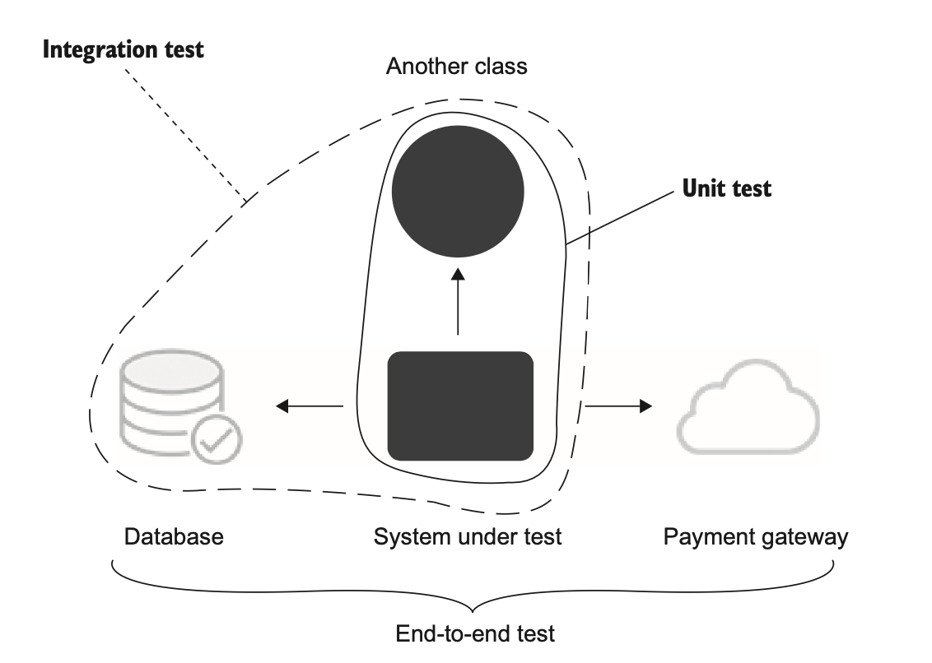
不同规模的测试相互之间有何关系？

Slide 11

测试的评价指标
Protection against regressions
Resistance to refactoring
Fast feedback
Maintainability

Slide 12
Protection against regressions
Regression is a software bug. It’s when a feature stops working as intended after some code modification, usually after you roll out new functionality.
To evaluate how well a test scores on the metric of protecting against regressions, you need to take into account the following:
The amount of code that is executed during the test
The complexity of that code
The code’s domain significance
可以理解为漏报率

Slide 13
Resistance to refactoring
Refactoring means changing existing code without modifying its observable behavior.
What is observable behavior of a UAT, observed by who ?
To evaluate how well a test scores on the metric of resisting to refactoring, you need to look at how many false positives the test generates. The fewer, the better.
可以理解为错报率

Slide 14
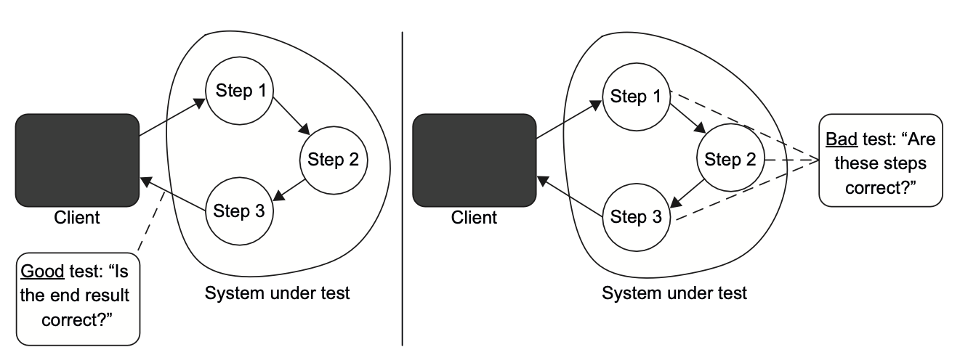
what cause false positive

Slide 15
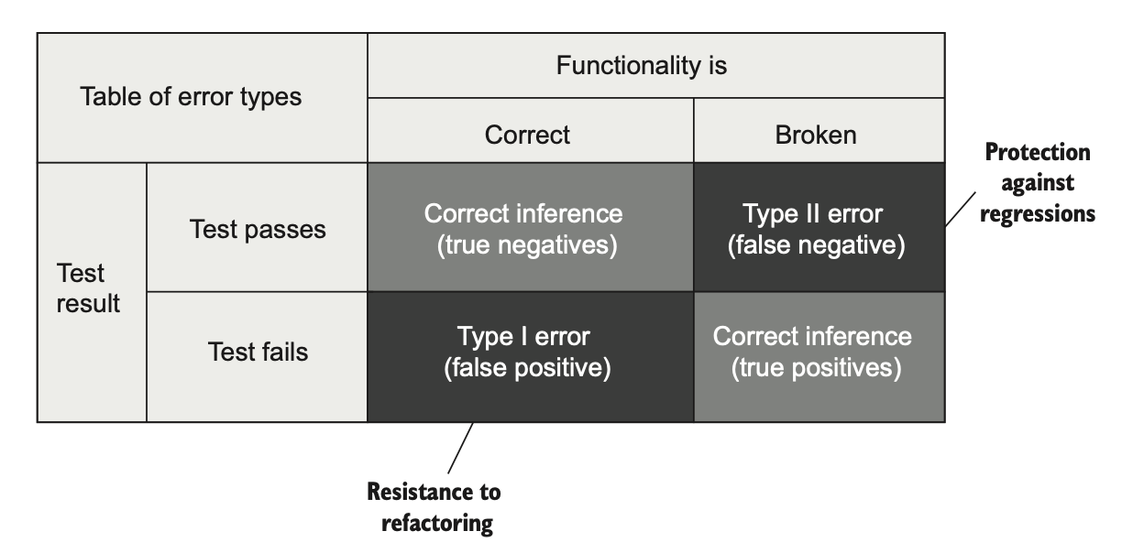
Maximizing test accuracy

Slide 16
Fast feedback & maintainability
The faster the tests, the more of them you can have in the suite and the more often you can run them.
How hard it is to understand the test
How hard it is to run the test

Slide 17
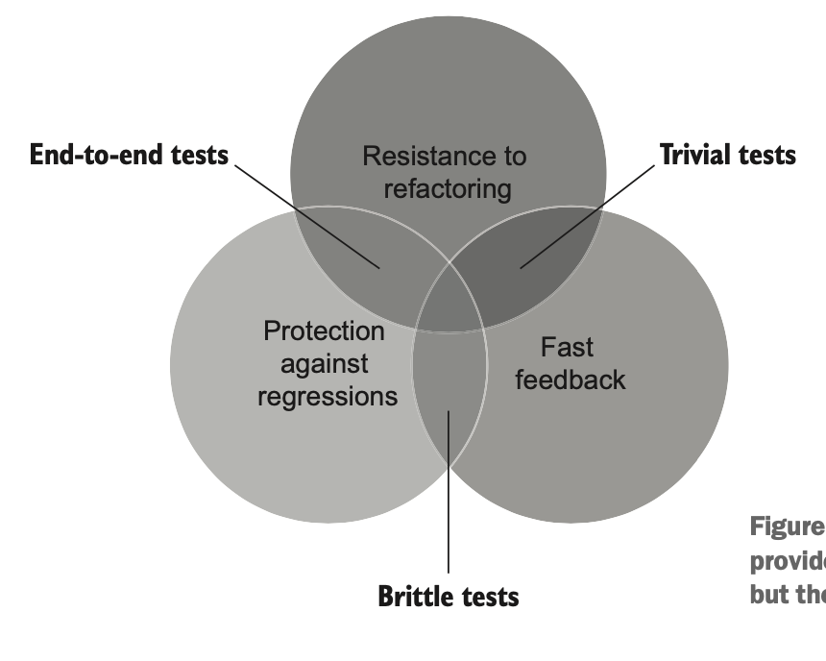
Is it possible to create an ideal test?

Slide 18
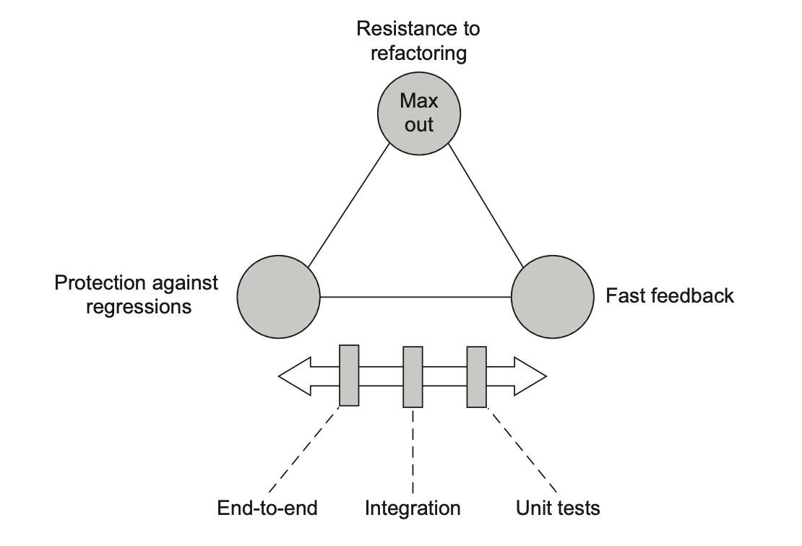
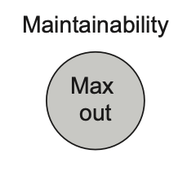
trade-off, between diff tests.

Slide 19
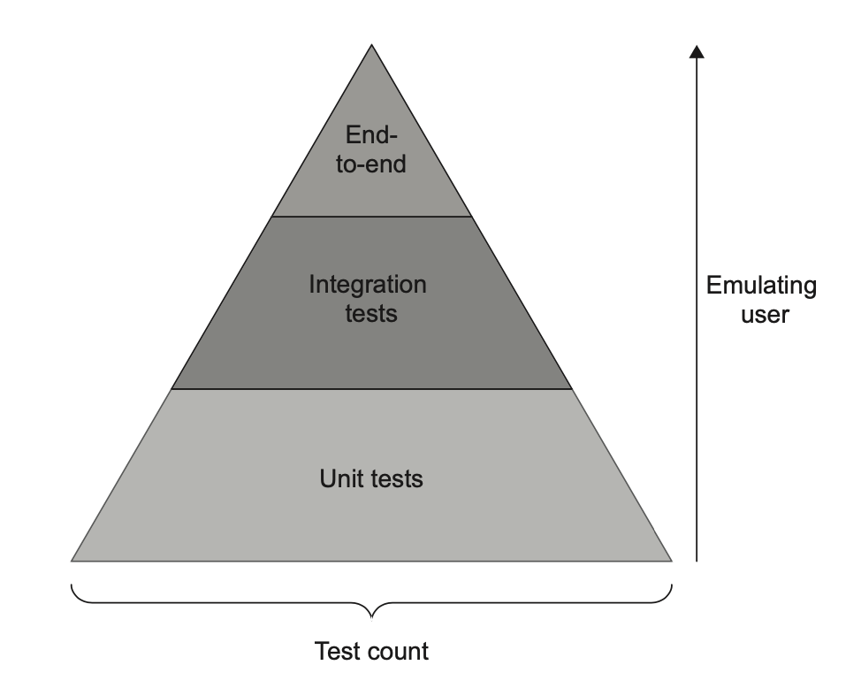
测试金字塔
why ?
The Test Pyramid is a concept that advocates for a certain ratio of different types of tests in the test suite

Slide 20
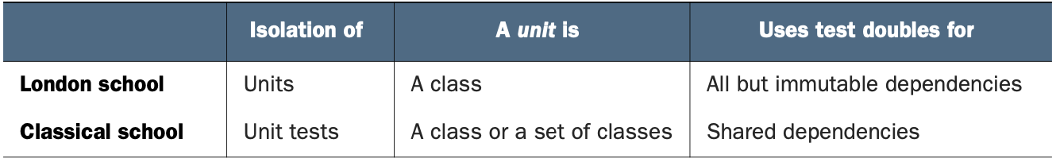

two school of unit test
school : 流派
The root of the differences between the London and classical schools is the isolation attribute. The London school views it as isolation of the system under test from its collaborators, whereas the classical school views it as isolation of unit tests themselves from each other.

Slide 21
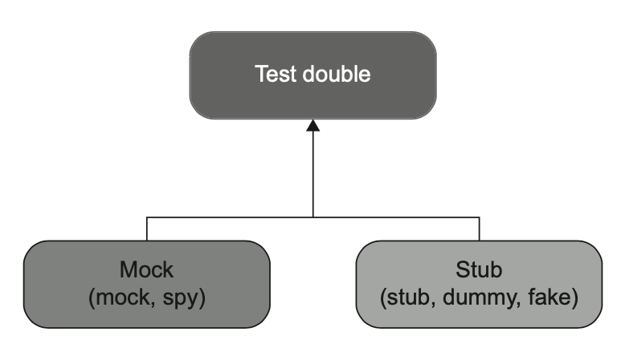
Mock
The term mock is overloaded and can mean different things in different circumstances.
See. Uses a mock (the tool) to create a mock (the test double) .

Slide 22
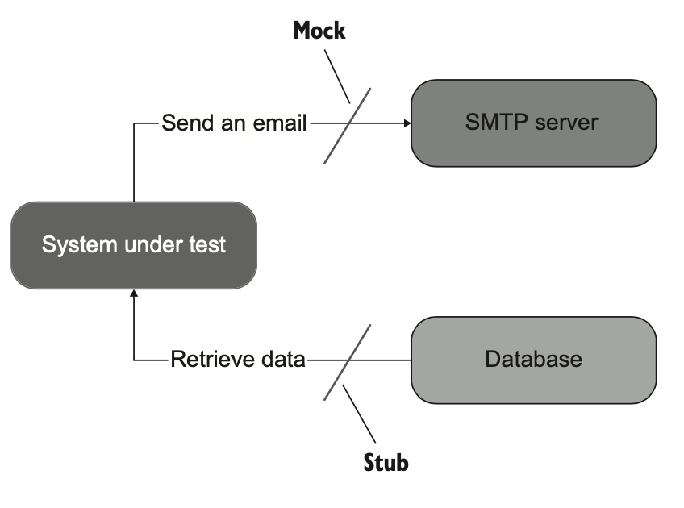
Mocks help to emulate and examine outcoming interactions between the SUT and its dependencies.
Stubs only help to emulate incoming interactions, not examine them.

Slide 23
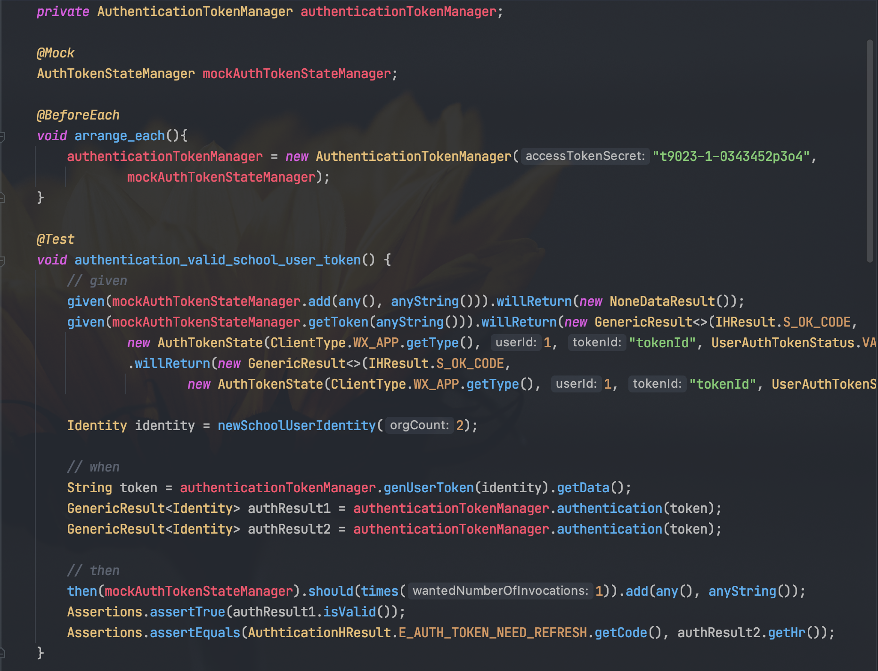
An example
both mock and stub.

Slide 24

tips
Don’t assert interactions with stubs.
A call from the SUT to a stub is not part of the end result the SUT produces.
(observable behavior)

Slide 25
review London school unit test
London school 维护成本更高。为什么？
答：在于两者对于隔离性的定义不同，London style需要更多的使用mock and stub，导致更多的over-specification 问题。

Slide 26
styles of unit testing
Output-based testing
State-based testing
Communication-based testing

Slide 27
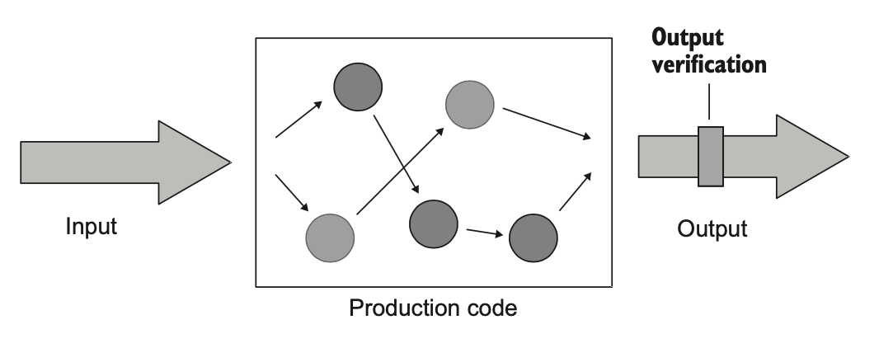
Output-based testing

Slide 28
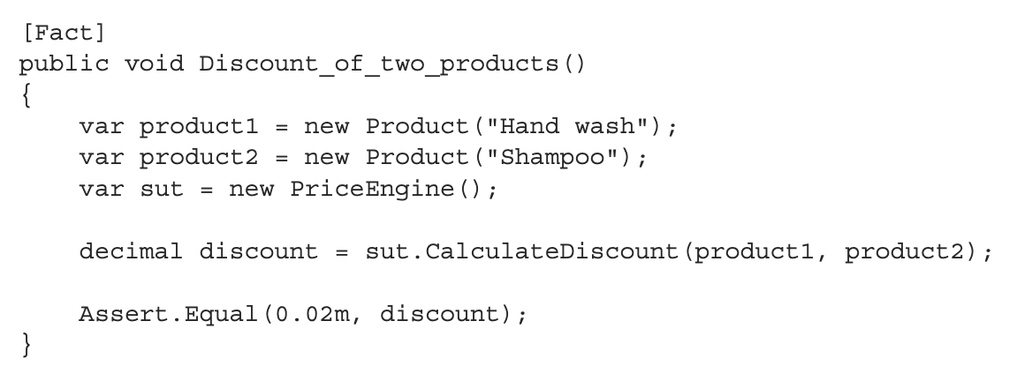
Output-based testing

Slide 29
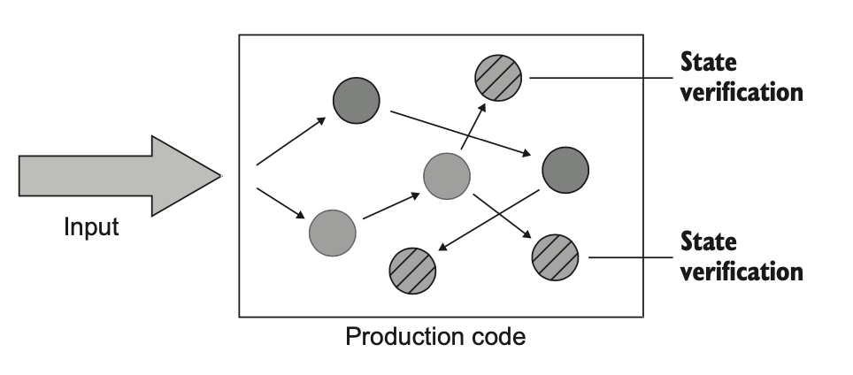
State-based testing

Slide 30
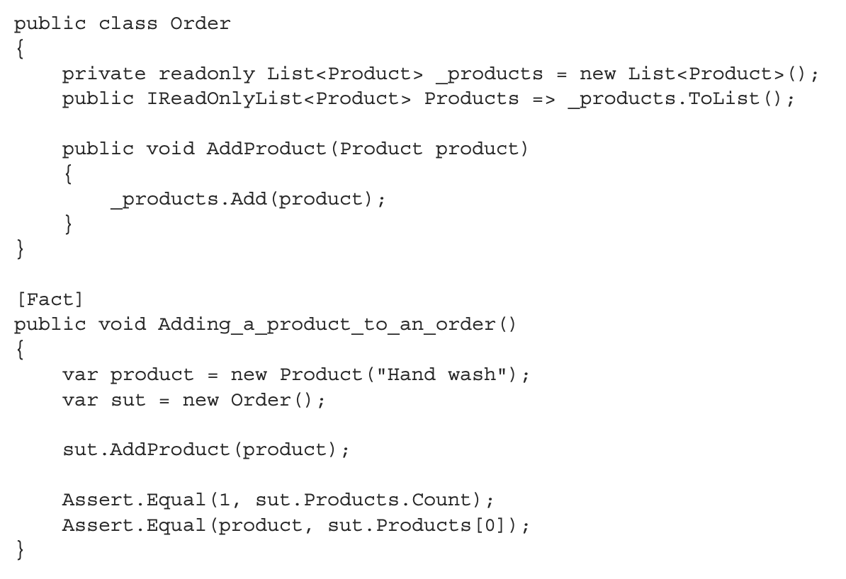
State-based testing

Slide 31
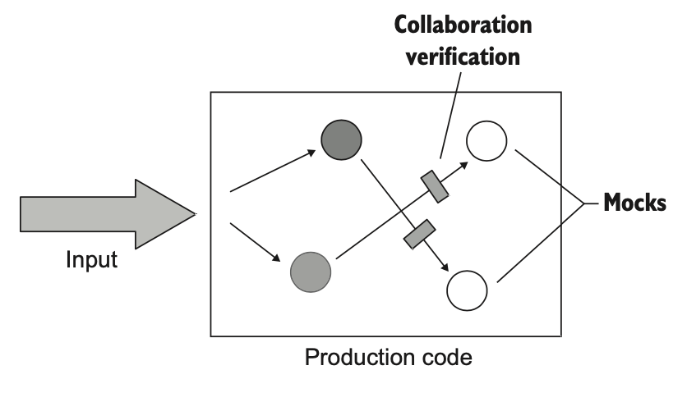
Communication-based testing

Slide 32
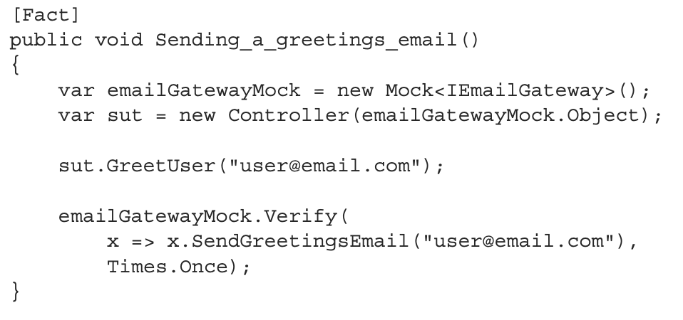
Communication-based testing

Slide 33

Styles and schools of unit testing
The classical school of unit testing prefers the state-based style over the communication- based one.
The London school makes the opposite choice.
Both schools use output- based testing.

Slide 34
Comparing the three styles of unit testing
 | Output-based | State-based | Communication-based
漏报可能性during modify
误报可能性during refctor
维护成本
运行速度
-
-
-
低
中
中+
低
中
高
-
-
-
Q: How to transition from state-based and collaboration- based testing to output-based testing ?

Slide 35
where
代码的分类
我们要给哪些代码写测试
测试覆盖率
我们的测试金字塔

Slide 36
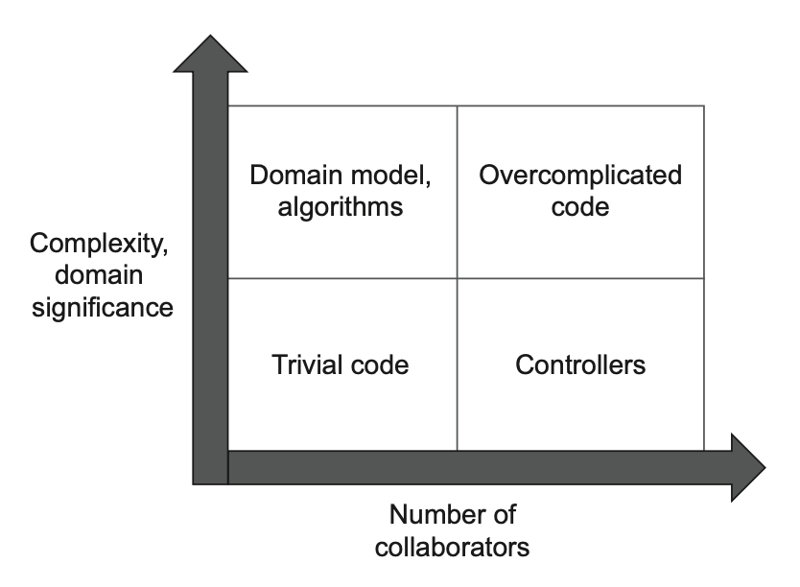
代码的分类
The more important or complex the code, the fewer collaborators it should have.

Slide 37
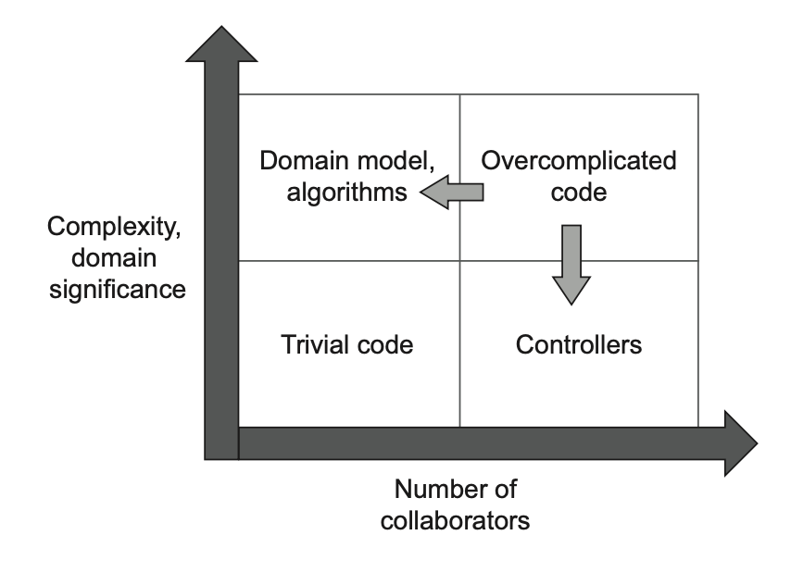
Identifying the code to refactor
Getting rid of the overcomplicated code and unit testing only the domain model and algorithms is the path to a highly valuable, easily maintainable test suite.

Slide 38
我们要给哪些代码写测试？

Slide 39
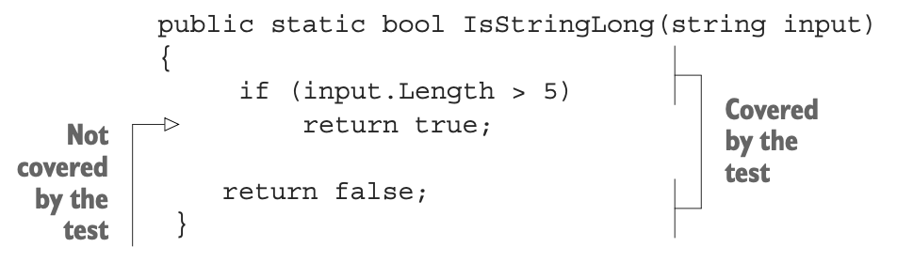
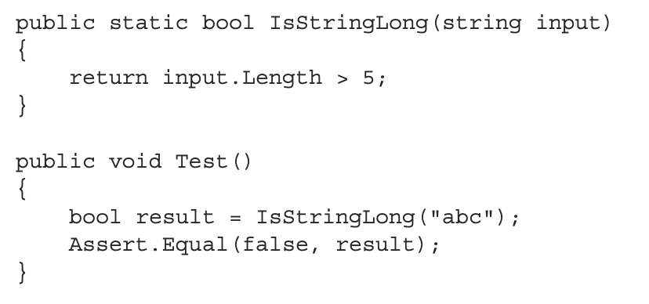
测试覆盖率计算（1）

Slide 40
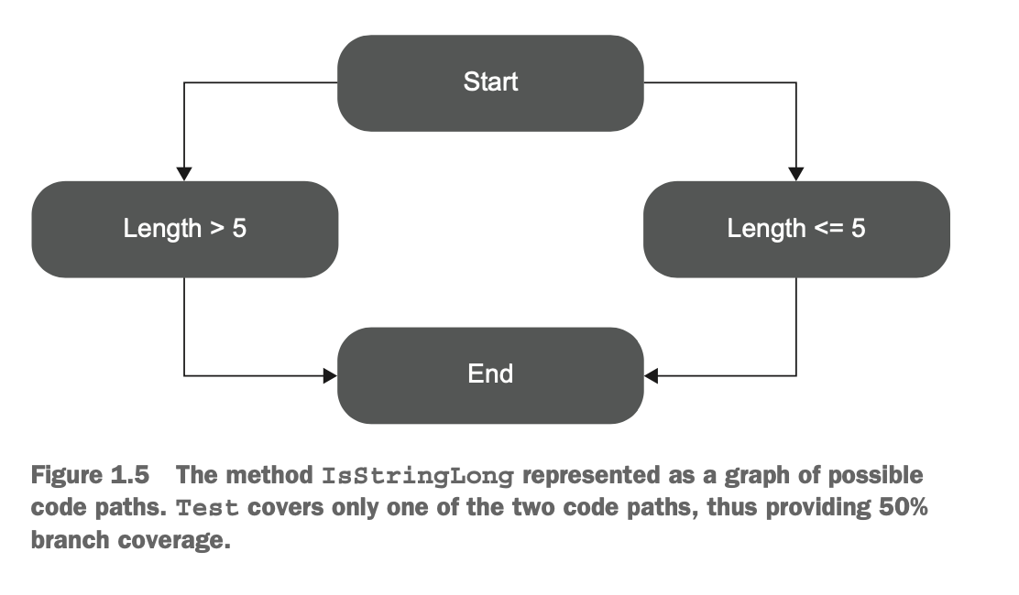
测试覆盖率计算（2）

Slide 41
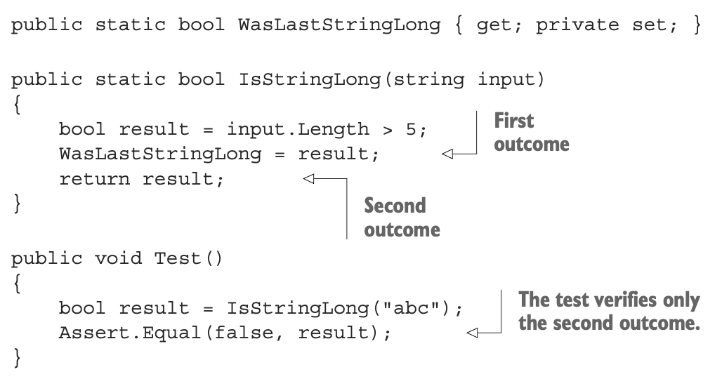
测试覆盖率不足（1）
You can’t guarantee that the test verifies all the possible outcomes of the system under test.

Slide 42
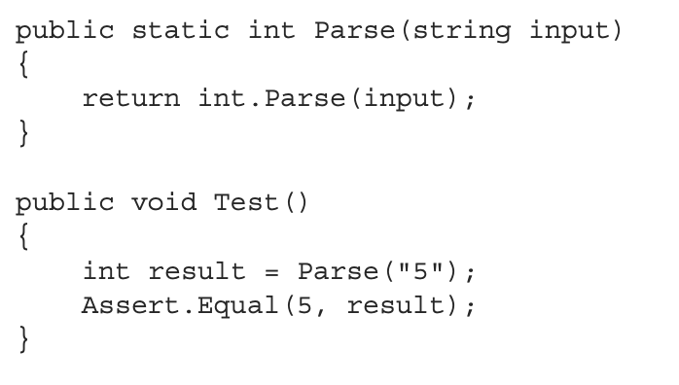
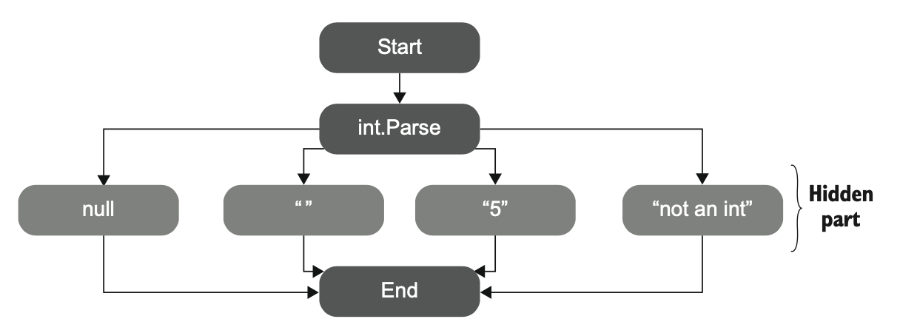
测试覆盖率不足（2）
No coverage metric can take into account code paths in external libraries.

Slide 43
如何看待测试覆盖率
Coverage metrics are a good negative indicator, but a bad positive one.
Low coverage numbers—say, below 60%—are a certain sign of trouble. They mean there’s a lot of untested code in your code base. But high numbers don’t mean anything.

Slide 44

我们的测试覆盖要求
controller
business logic
data access

Slide 45

how
工具/框架的选择
三层结构中各层的测试原则
三层结构各层测试举例
测试书写规范
反模式介绍
实践技巧介绍

Slide 46
工具/框架的选择
https://junit.org/junit5/docs/current/user-guide/
test NG ?
https://docs.spring.io/spring-framework/docs/current/reference/html/testing.html
https://site.mockito.org

Slide 47
dal层测试
为什么想要对dal方法写单元测试？
想确定sql有没有问题
习惯于阶段性测试
jdbc 是否需要mock 或者使用内存数据库
如何清理测试数据（尤其是在test异常中断时）

Slide 48
bll层测试
should isolate shared dependencies ？
memcache
kafka
http service
shared dal

Slide 49
controller层测试

Slide 50
Testable code
Constructor does Real Work
Digging into Collaborators
Brittle Global State & Singletons
Class Does Too Much
see: http://misko.hevery.com/code-reviewers-guide/flaw-constructor-does-real-work/

Slide 51
how
工具/框架的选择
三层结构中各层的测试原则
三层结构各层测试举例
测试书写规范
反模式介绍
实践技巧介绍

Slide 52
Naming a unit test
[MethodUnderTest]_[Scenario]_[ExpectedResult]
public void Sum_TwoNumbers_ReturnsSum()
public void IsDeliveryValid_InvalidDate_ReturnsFalse()

Slide 53
Unit test naming guidelines
Don’t follow a rigid naming policy. You simply can’t fit a high-level description of a complex behavior into the narrow box of such a policy. Allow freedom of expression.
Name the test as if you were describing the scenario to a non-programmer who is familiar with the problem domain. A domain expert or a business analyst is a good example.
Separate words with underscores. Doing so helps improve readability, especially in long names.

Slide 54
Example: Renaming a test toward the guidelines
IsDeliveryValid_InvalidDate_ReturnsFalse()
Delivery_with_invalid_date_should_be_considered_invalid()
Delivery_with_past_date_should_be_considered_invalid()
Delivery_with_past_date_should_be_invalid()
Delivery_with_past_date_is_invalid()
Delivery_with_a_past_date_is_invalid()

Slide 55
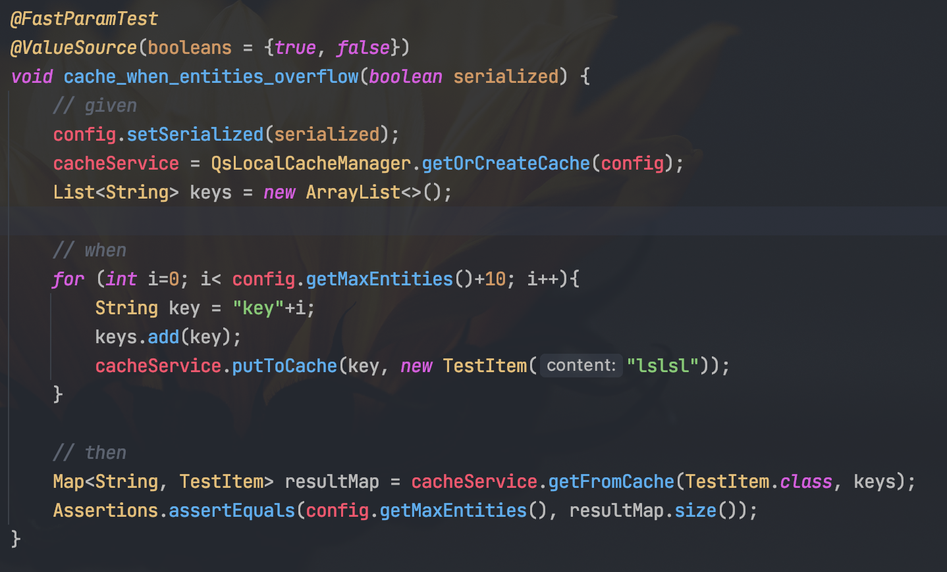
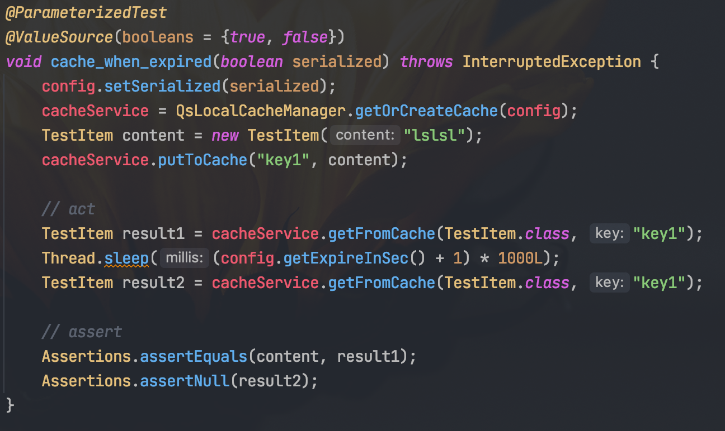
naming : bad cases

Slide 56
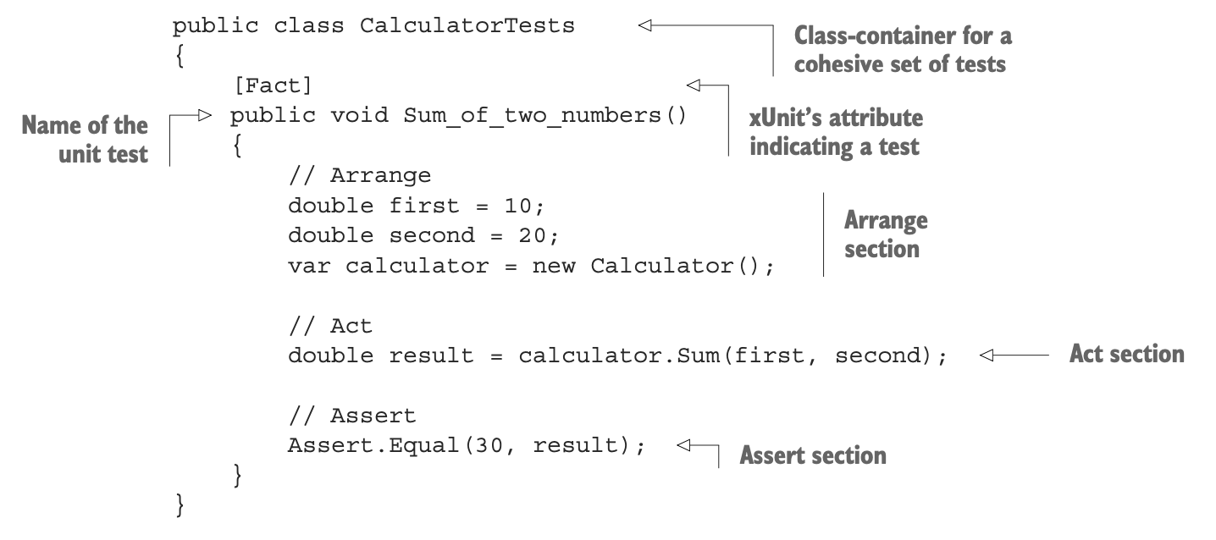
pattern: aaa

Slide 57
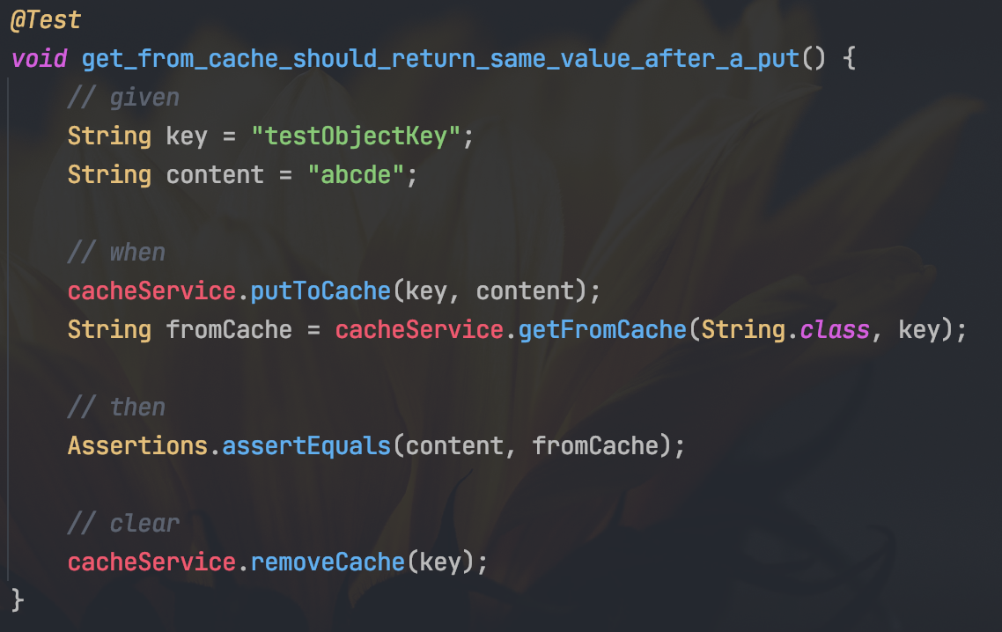
pattern: bdd

Slide 58
how
工具/框架的选择
三层结构中各层的测试原则
三层结构各层测试举例
测试书写规范
反模式介绍
实践技巧介绍

Slide 59
bade cases
Unit testing private method
Exposing private state
Leaking domain knowledge to tests
Code pollution
滥用 spy
执行速度慢，导致没人愿意执行
依赖特定环境才能执行
不可重复执行，不可乱序执行
不认真对待测试
测试代码书写随意，不简洁，导致维护成本过高
测试点不充分，不能报告代码错误，导致unit test不可信
不通过测试直接注释掉，导致unit test越来越不可信

Slide 60
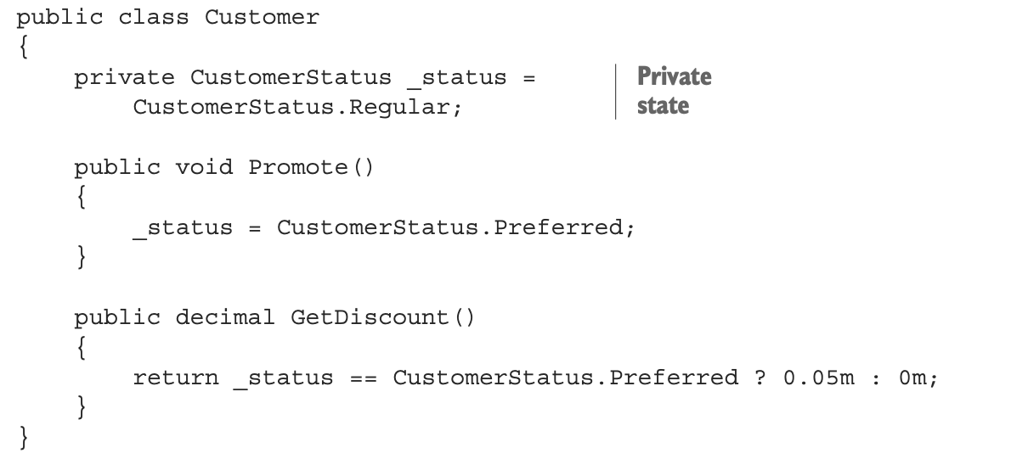
Exposing private state
Your tests should interact with the system under test (SUT) exactly the same way as the production code and shouldn’t have any special privileges.
Widening the public API surface for the sake of testability is a bad practice.
How would you test the Promote() method?

Slide 61
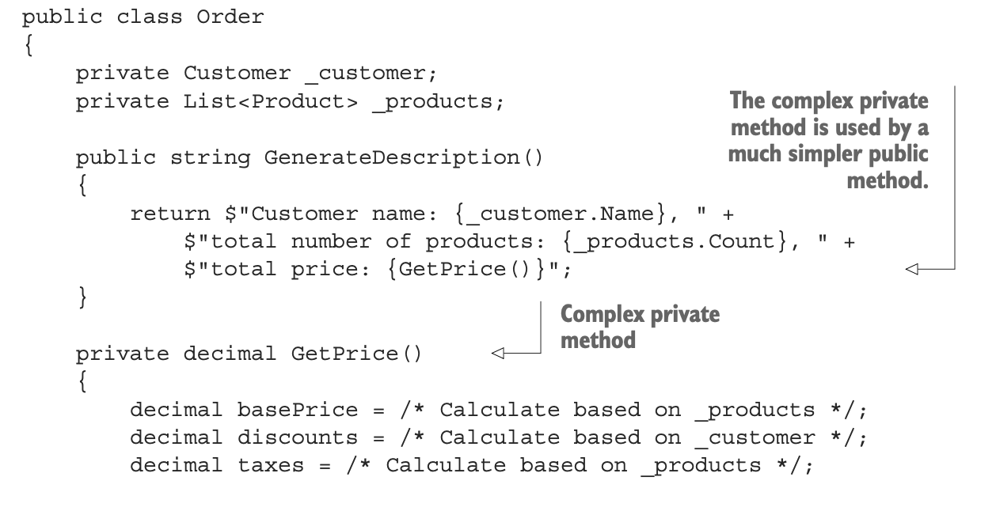
Unit testing private method

Slide 62
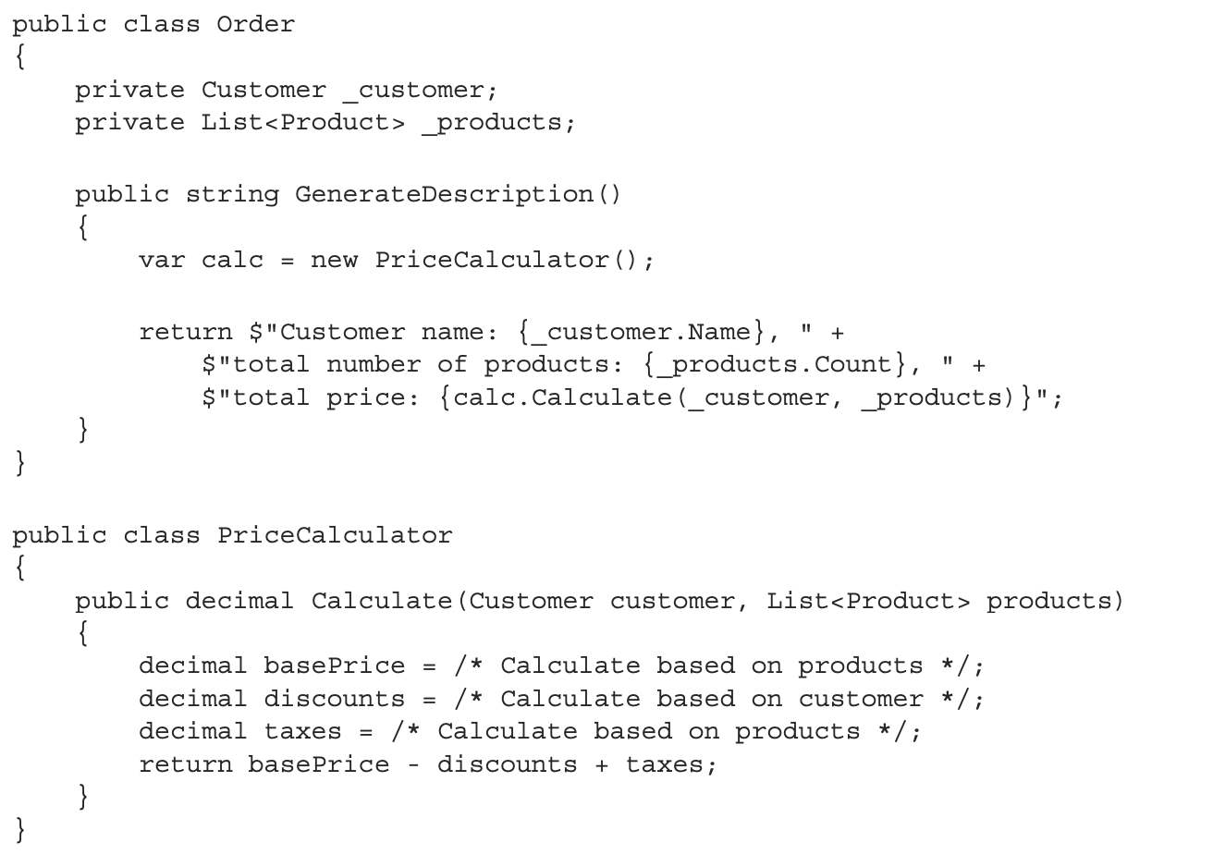
solution
Think about encapsulation: making the observable behavior public and implementation details private results in a well-designed API.

Slide 63
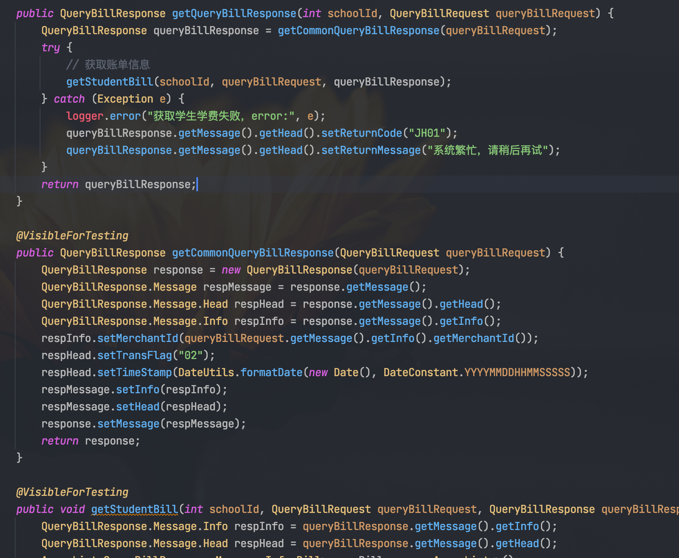
慎用 VisibleForTesting 注解
Testing observable behavior, not implementation detail
You can check sub step’s result when debugging the test

Slide 64
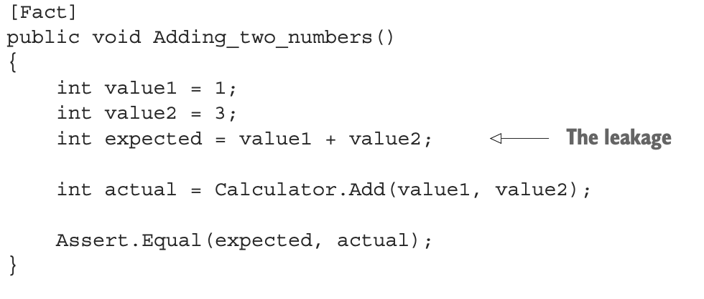
Leaking domain knowledge to tests
The test duplicate the algorithm implementation from the production code

Slide 65
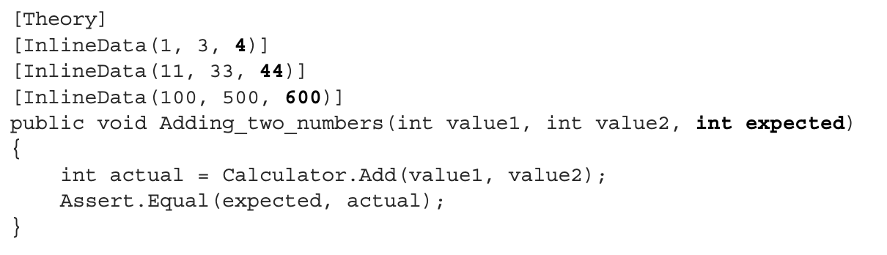
Solution
Don’t imply any specific implementation when writing tests.

Slide 66
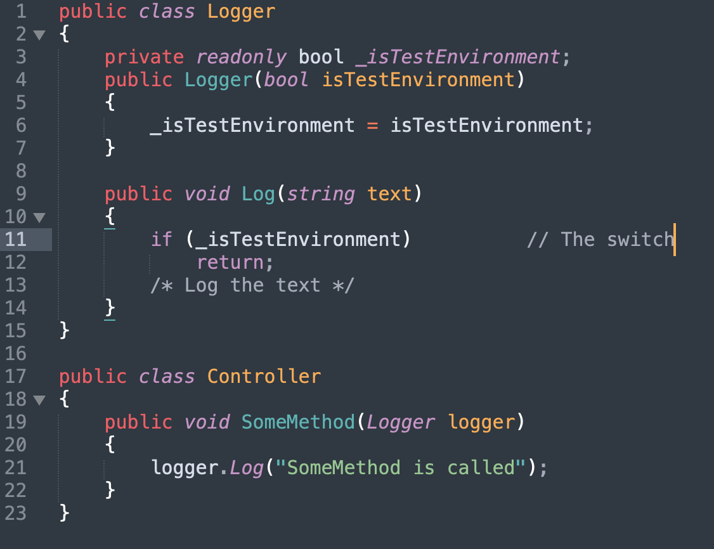
Code pollution(污染)

Slide 67
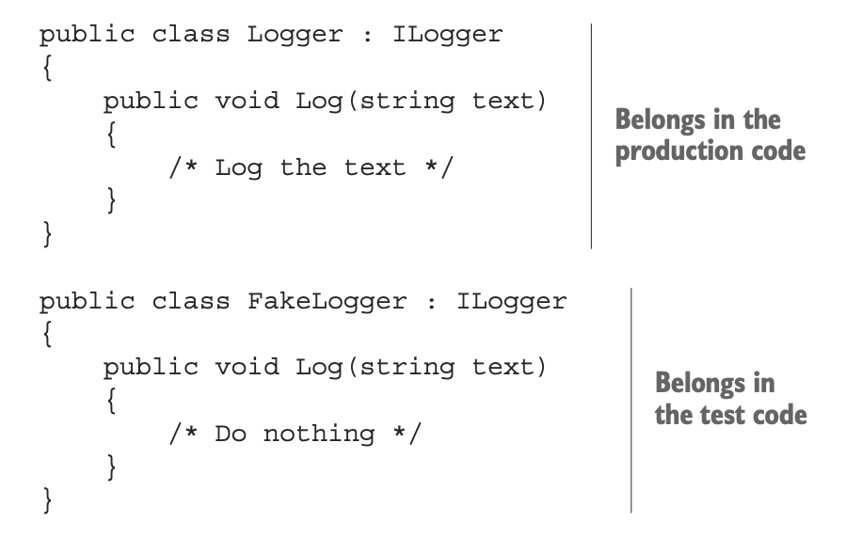
solution

Slide 68
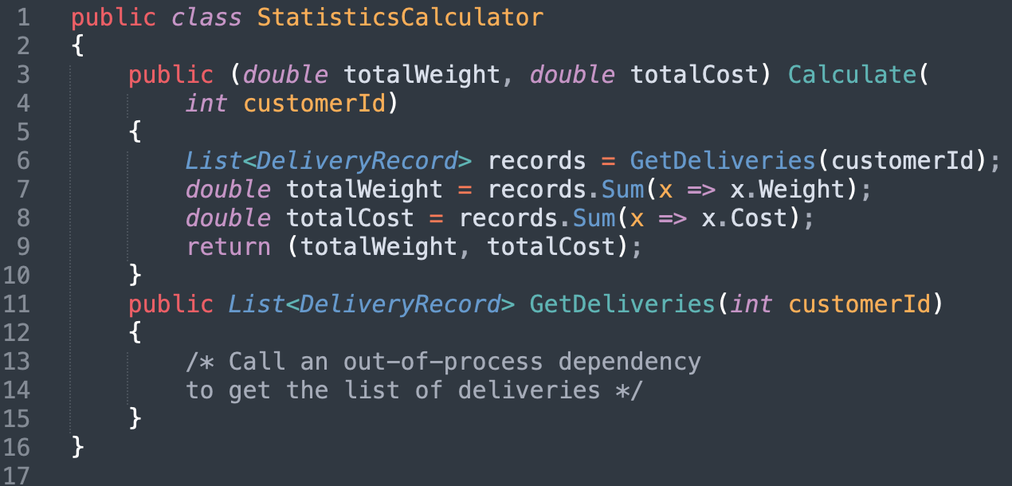
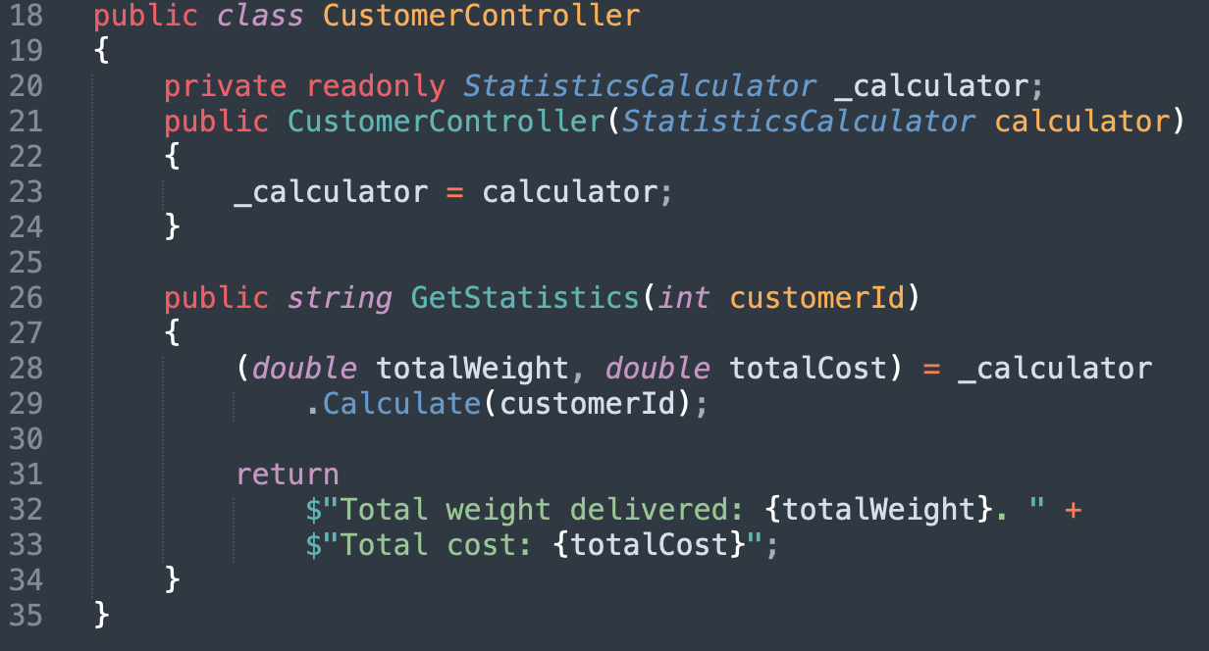
cONTEXT
How to test
the controller

Slide 69
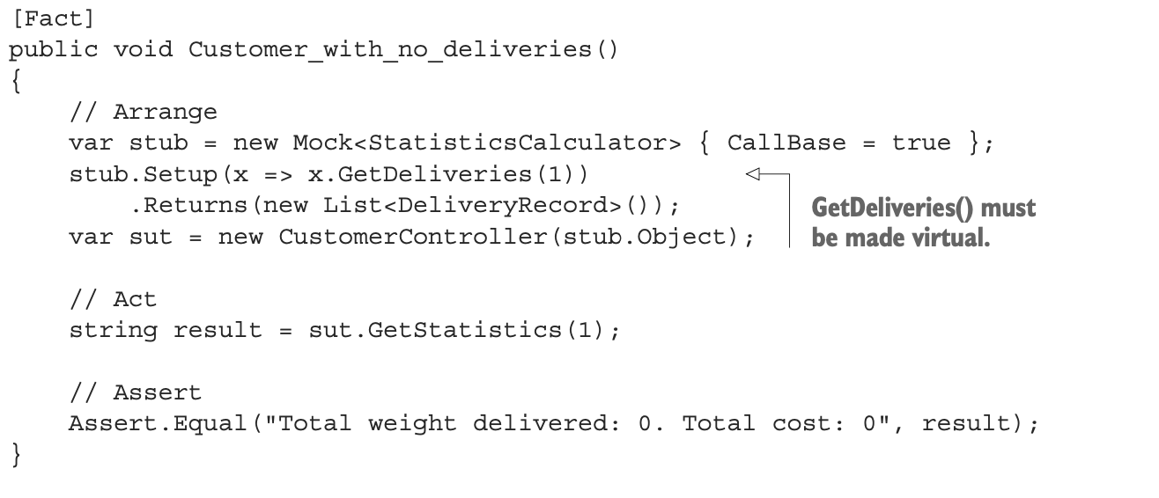
SOLUTION: partial mock / spy

Slide 70
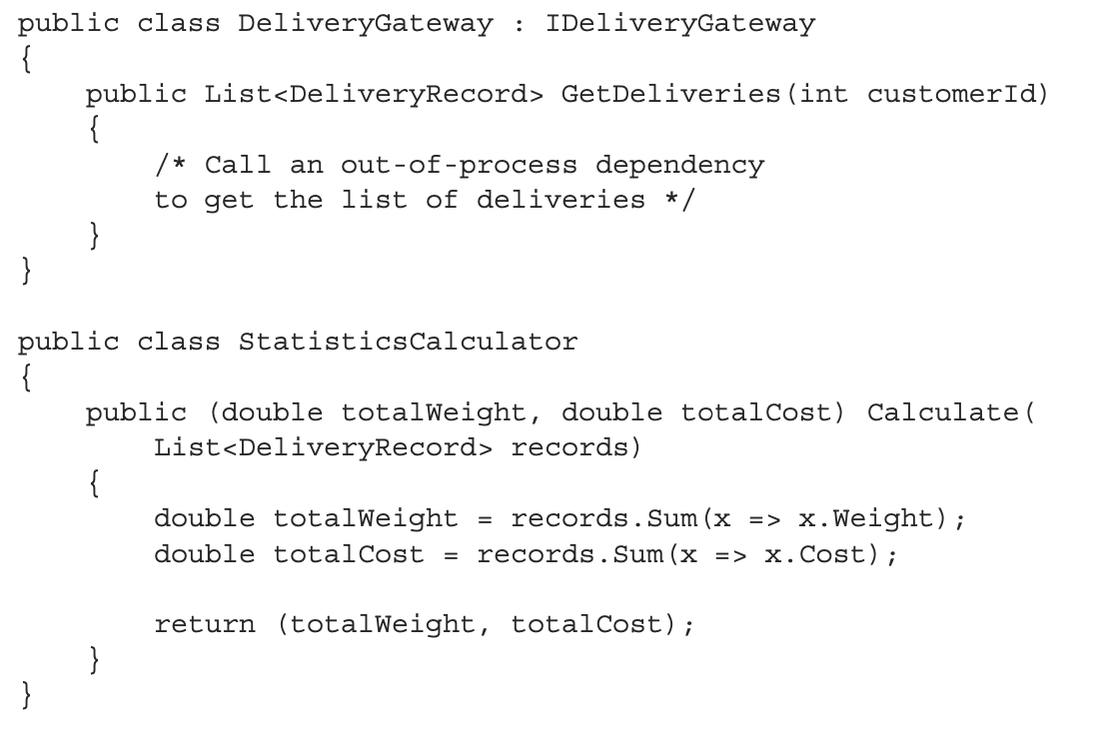
BETTER SOLUTION
单一职责、依赖注入

Slide 71
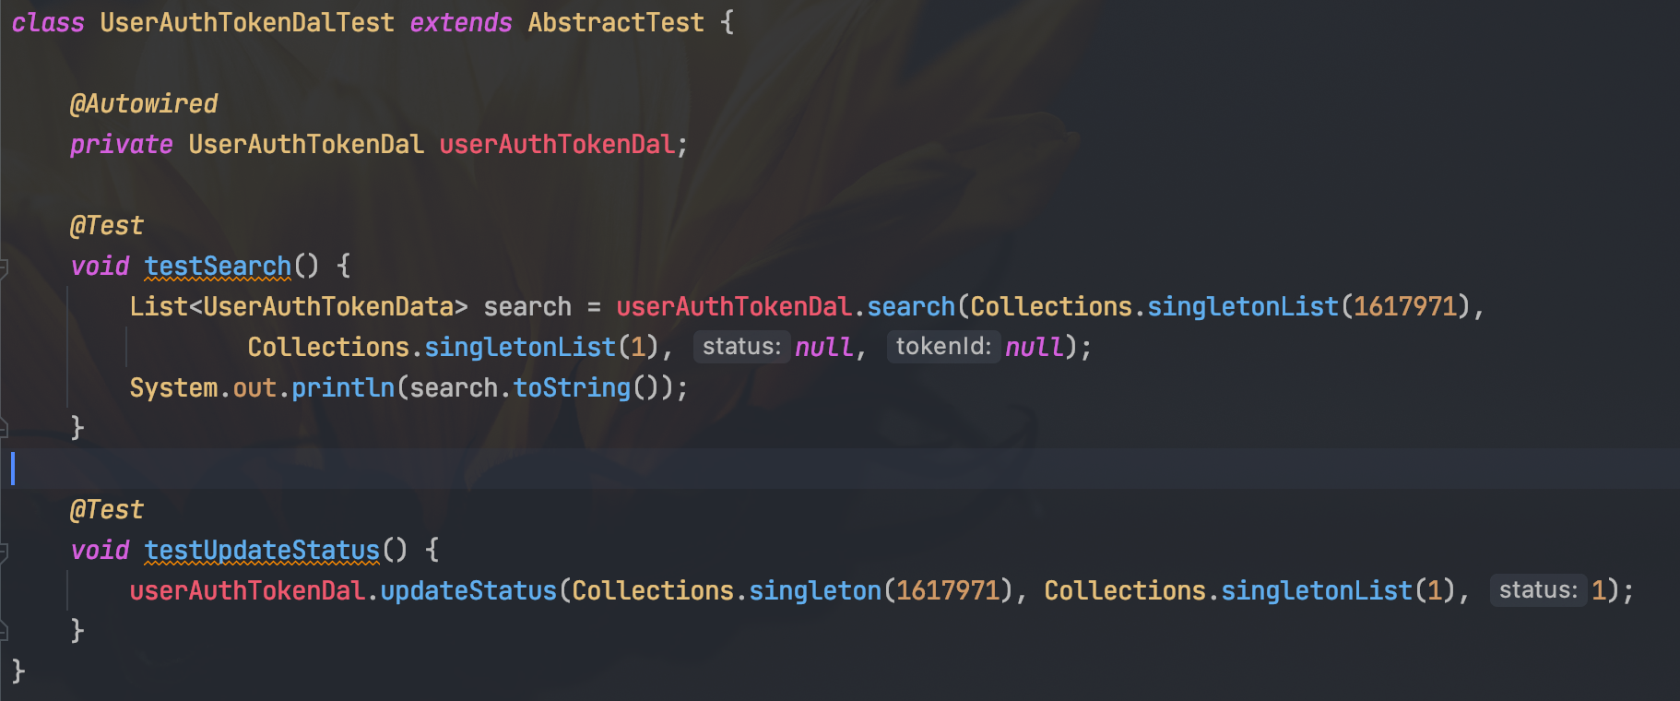
依赖环境

Slide 72
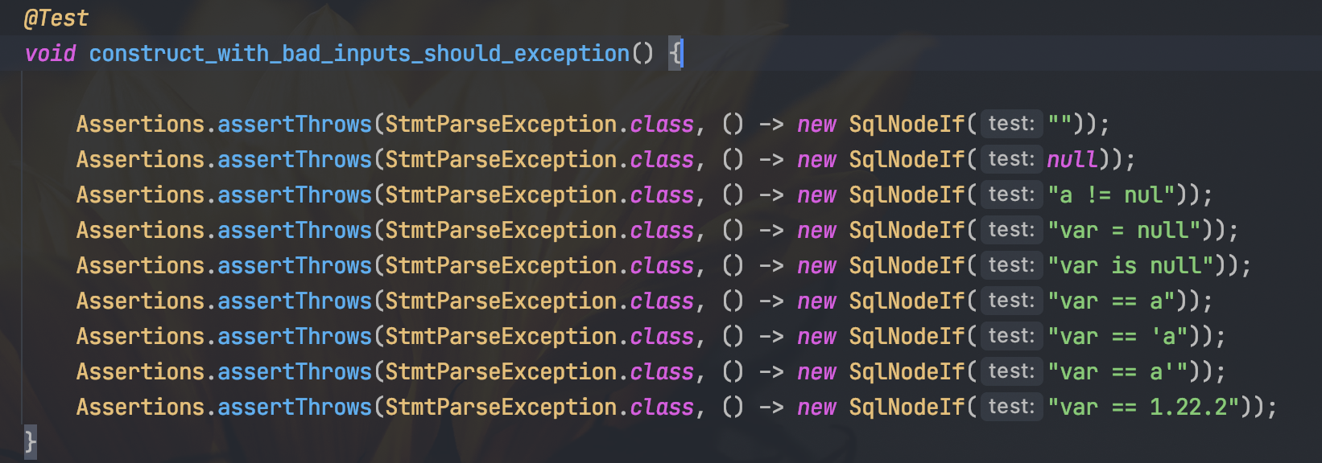
测试不充分

Slide 73
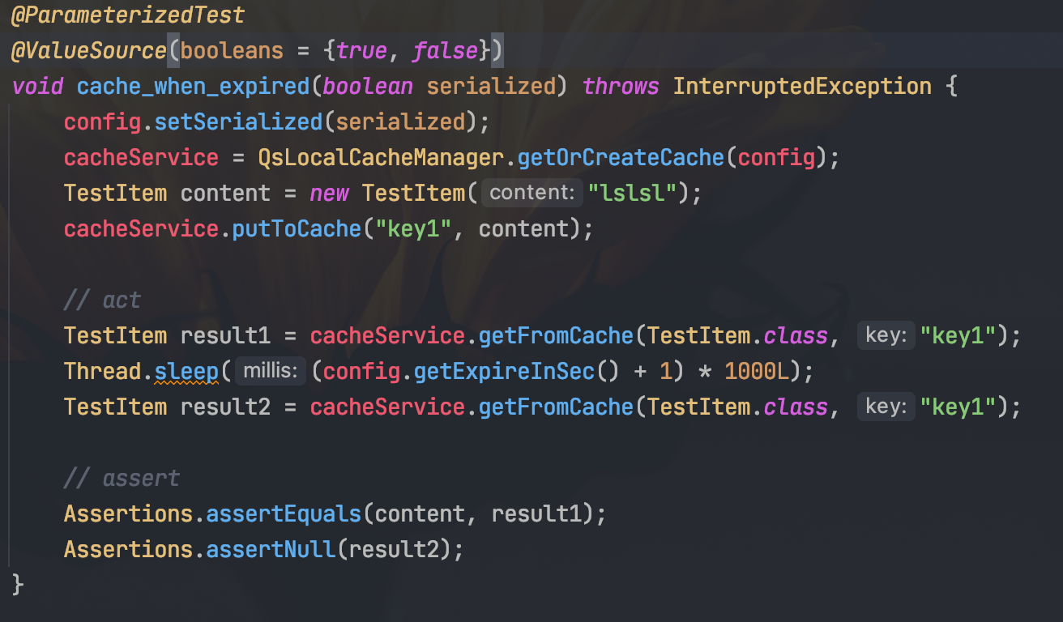
执行慢

Slide 74
all in all
方便执行
任意环境、任意时刻、任意顺序
速度要快
执行结果要可信
一个类要么不测，要测就要写全测试点
不要在维护的过程中简化测试点
维护成本要低
testing behavior, not impl detail
规范
测试最需要测试的代码

Slide 75
how
工具/框架的选择
三层结构中各层的测试原则
三层结构各层测试举例
测试书写规范
反模式介绍
实践技巧介绍

Slide 76
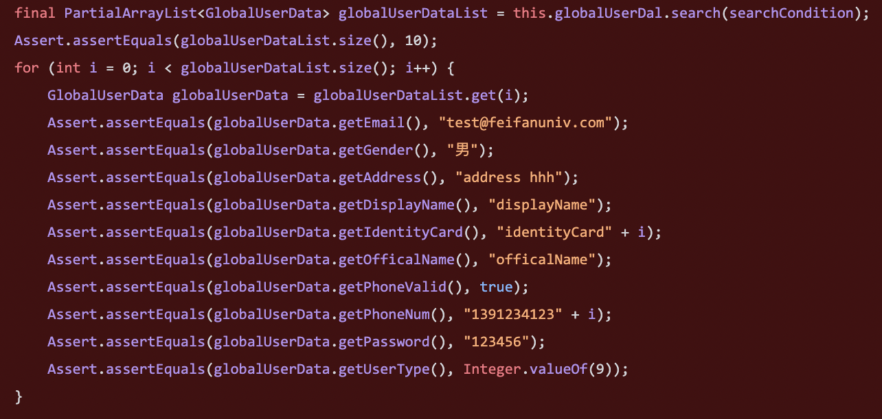
对象/集合的assert equal
写起来很烦
容易写错
违反test应当尽量简洁的原则

Slide 77
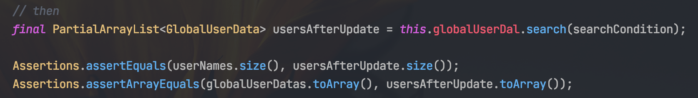
assert Array Equals

Slide 78
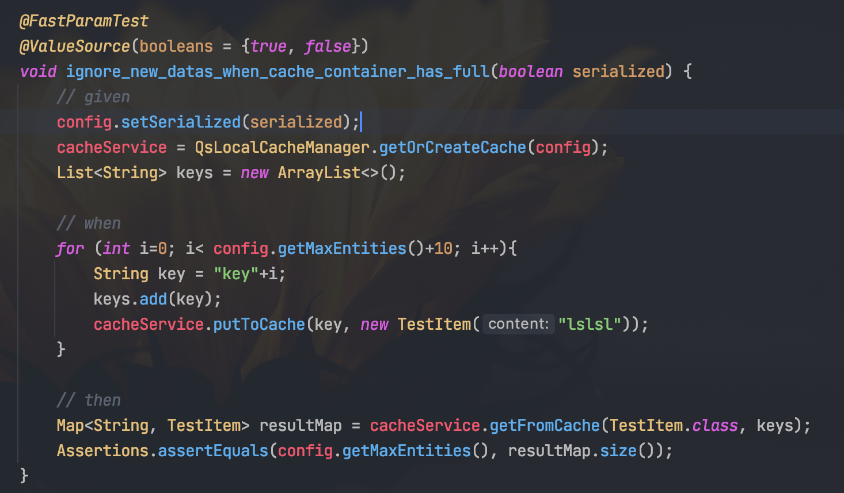
参数化测试

Slide 79
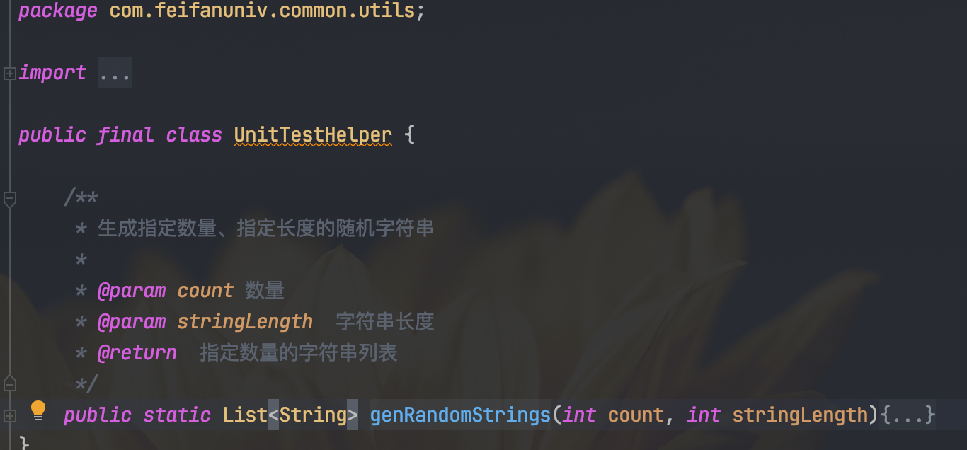
封装工具方法
level1：封装到common library
level2：封装在当前module
level3：封装在当前test class

Slide 80
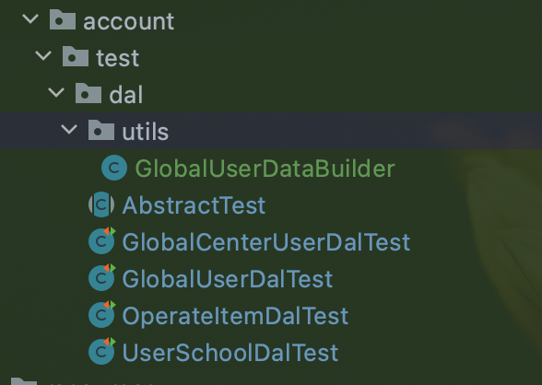

封装工具方法
level1：封装到common library
level2：封装在当前module
level3：封装在当前test class

Slide 81

封装工具方法
level1：封装到common library
level2：封装在当前module
level3：封装在当前test class

Slide 82
when
Integrated into the development cycle.
研发设计
01
coding/refactor
local test
code review
02
coding/refactor
local test
code review
03
coding/refactor
local test
code review
04
e2e test
05

Slide 83
测试的执行
本地 maven 执行
代码merge前自动执行
GITLAB

Slide 84
What makes a successful test suite?
It’s integrated into the development cycle
It targets only the most important parts of your code base
It provides maximum value with minimum maintenance costs

Slide 85




some reading
http://misko.hevery.com/code-reviewers-guide/
https://martinfowler.com/bliki/UnitTest.html
https://martinfowler.com/bliki/IntegrationTest.html
https://martinfowler.com/articles/mocksArentStubs.html
https://javadoc.io/doc/org.mockito/mockito-core/latest/org/mockito/Mockito.html
https://github.com/mockito/mockito/wiki/Using-Spies-%28and-Fakes%29

Slide 86

thanks!

